Slide 1

JAWAHARLAL NEHRU TECHNOLOGICAL UNIVERSITY HYDERABAD UNIVERSITY COLLEGE OF ENGINEERING MANTHANI
Centenary Colony(Po),Pannur(Vil),Ramagiri(Mdl),Peddapalli,Telangana-505212,India
DEPARTMENT OF COMPUTER SCIENCE AND ENGINEERING
PREDICTION OF CYBER-TOXIC COMMENTS ON SOCIAL MEDIA USING MACHINE LEARNING
Under the guidance of :
TEAM MEMBERS :
N.VAMSHI KRISHNA
(Asst. Professor(C))
Ch. Sowmya (20VD1A0541)
K. Anil Kumar (20VD1A0506)
Ch. Kumaraswamy (20VD1A0517)
B. Sangeetha (20VD1A0557)

Slide 2
CONTENTS
Introduction
Problem Statement
Existing System
Limitations Of Existing System
Proposed System
System Requirement Specification
Scope
Model Design
Model Architecture
Implementation
Conclusion

Slide 3
INTRODUCTION
Advancements in technology led to the Internet, transforming global communication. Early email suffered from spam, complicating message categorization. Rise of social media highlights the need to classify content for societal safety and addressing antisocial conduct.
Toxic comments on social media make the internet unsafe and negatively impact people. Detecting toxicity requires a specific procedure and the application of classification techniques.

Slide 4
PROBLEM STATEMENT
Develop a machine learning system to predict and identify instances of cyber-toxicity in social media content. This system should analyze user-generated text data and classify it as either cyber-toxic or non-toxic, contributing to the creation of safer online environments and proactive moderation strategies.
The aim is to deploy a real-time solution that assists in monitoring and mitigating the harmful impact of cyber-toxicity on social media platforms.

Slide 5
EXISTING SYSTEM
The existing system for classifying toxic comments using machine learning might involve techniques like natural language processing(NLP) and supervised learning algorithms. This system would likely require labelled data, where comments are categorized as toxic and non-toxic.

Slide 6
LIMITATIONS OF EXISTING SYSTEM
Data bias
Limited context understanding
Dynamic language usage
Difficulty in handling contextual changes
Interpretability
Imbalanced Data
Evolution of Language
Human-Machine Collaboration

Slide 7
PROPOSED SYSTEM
The proposed system could potentially improve upon the existing one by incorporating more advanced NLP techniques, utilizing larger and more diverse data sets, and exploring newer machine-learning algorithms. It might also consider techniques like transfer learning using pre-trained language models, which have shown promising results in various NLP tasks.

Slide 8
SOFTWARE REQUIREMENT SPECIFICATION
HARDWARE REQUIREMENTS
Processor : Intel Core i5.
Hard Disk : 40 GB.
Ram : 512 Mb.
SOFTWARE REQUIREMENTS
Operating System :Windows Family
Coding Language : Python 3.11

Slide 9
SCOPE
The scope for predicting cyber-toxic comments on social media using machine learning involves addressing the pressing issue of online toxicity by collecting and annotating diverse datasets, developing natural language processing algorithms for comment analysis, and implementing models like supervised classifiers or advanced deep learning techniques.
This comprehensive approach aims to contribute to a safer online environment through proactive content moderation and the promotion of positive digital interactions.

Slide 10
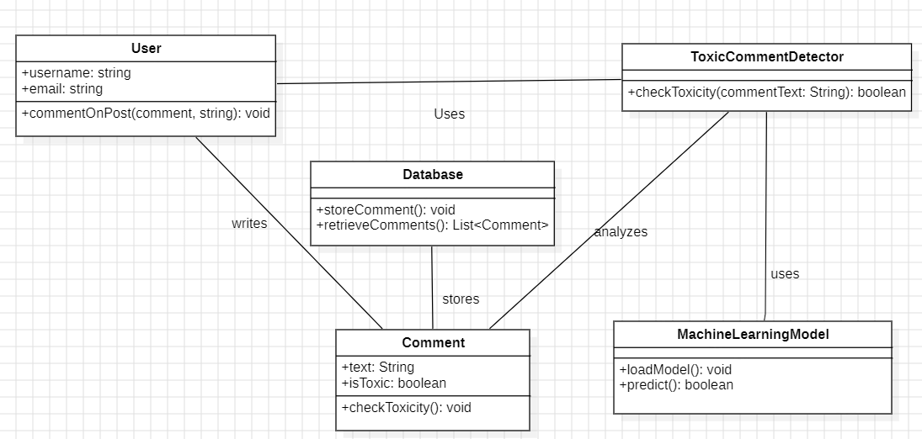
MODEL DESIGN
CLASS DIAGRAM

Slide 11
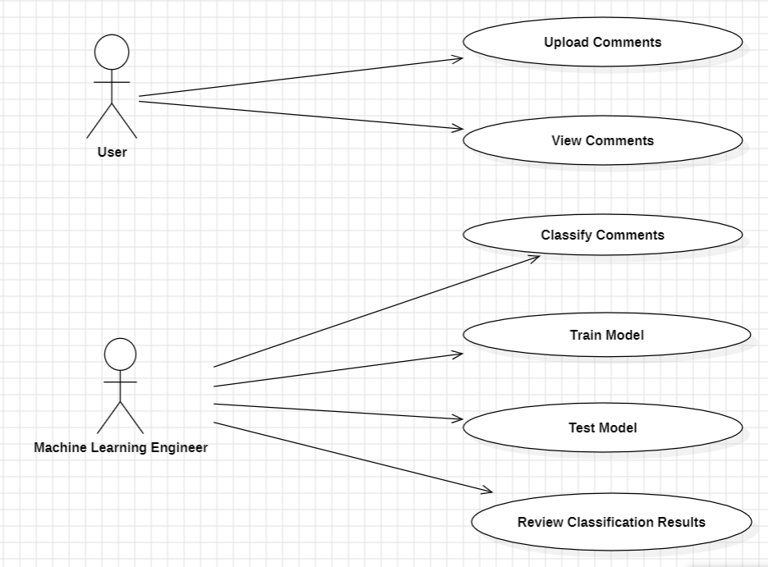
USECASE DIAGRAM

Slide 12
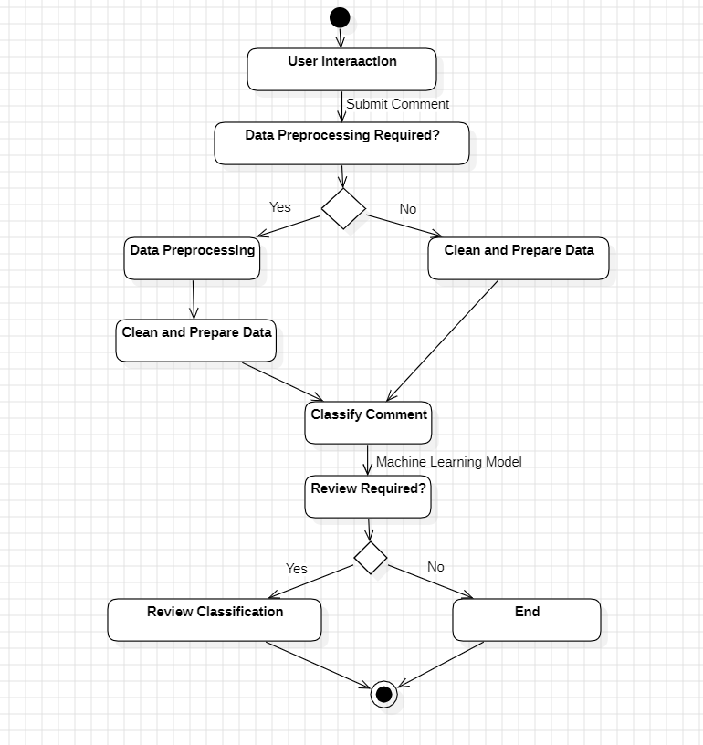
ACTIVITY DIAGRAM

Slide 13
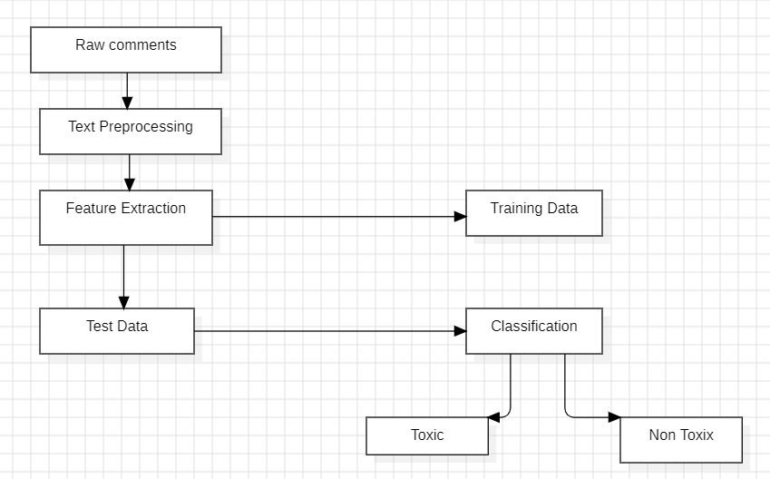
MODEL ARCHITECTURE

Slide 14
IMPLEMENTATION
from tkinter import messagebox
from tkinter import *
from tkinter import simpledialog
import tkinter
import matplotlib.pyplot as plt
import numpy as np
from tkinter import ttk
from tkinter import filedialog
import pandas as pd
from sklearn.model_selection import train_test_split
from string import punctuation
from nltk.corpus import stopwords
import nltk
from nltk.stem import WordNetLemmatizer
from sklearn.feature_extraction.text import TfidfVectorizer
from sklearn.metrics import accuracy_score
from sklearn import svm
from sklearn.naive_bayes import GaussianNB
from sklearn.ensemble import RandomForestClassifier
from sklearn.linear_model import LogisticRegression

Slide 15
from sklearn.neighbors import KNeighborsClassifier
from sklearn.tree import DecisionTreeClassifier
from sklearn.metrics import hamming_loss
main = Tk()
main.title("Classification of Online Toxic Comments Using Machine Learning Algorithms")
main.geometry("1300x1200")
global filename
global X, Y1, Y2, Y3, Y4, Y5, Y6
accuracy = []
global X_train, X_test, y_train, y_test
loss = []
stop_words = set(stopwords.words('english'))
lemmatizer = WordNetLemmatizer()
textdata = []
global classifier1,classifier2,classifier3,classifier4,classifier5,classifier6
global tfidf_vectorizer

Slide 16
def cleanPost(doc):
tokens = doc.split()
table = str.maketrans('', '', punctuation)
tokens = [w.translate(table) for w in tokens]
tokens = [word for word in tokens if word.isalpha()]
tokens = [w for w in tokens if not w in stop_words]
tokens = [word for word in tokens if len(word) > 1]
tokens = [lemmatizer.lemmatize(token) for token in tokens]
tokens = ' '.join(tokens)
return tokens
def uploadDataset():
global filename
text.delete('1.0', END)
filename = filedialog.askopenfilename(initialdir="Dataset")
text.insert(END,filename+" loaded\n")

Slide 17
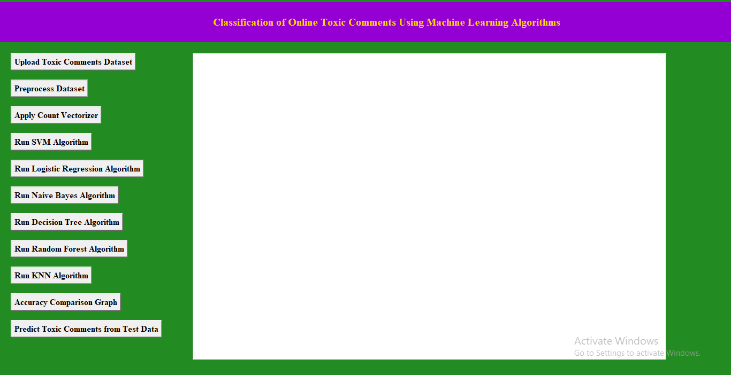
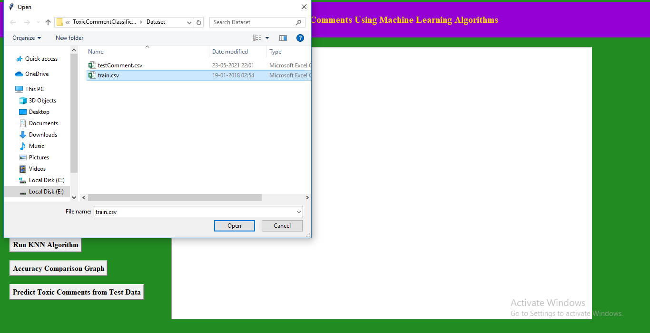
RESULTS

Slide 18
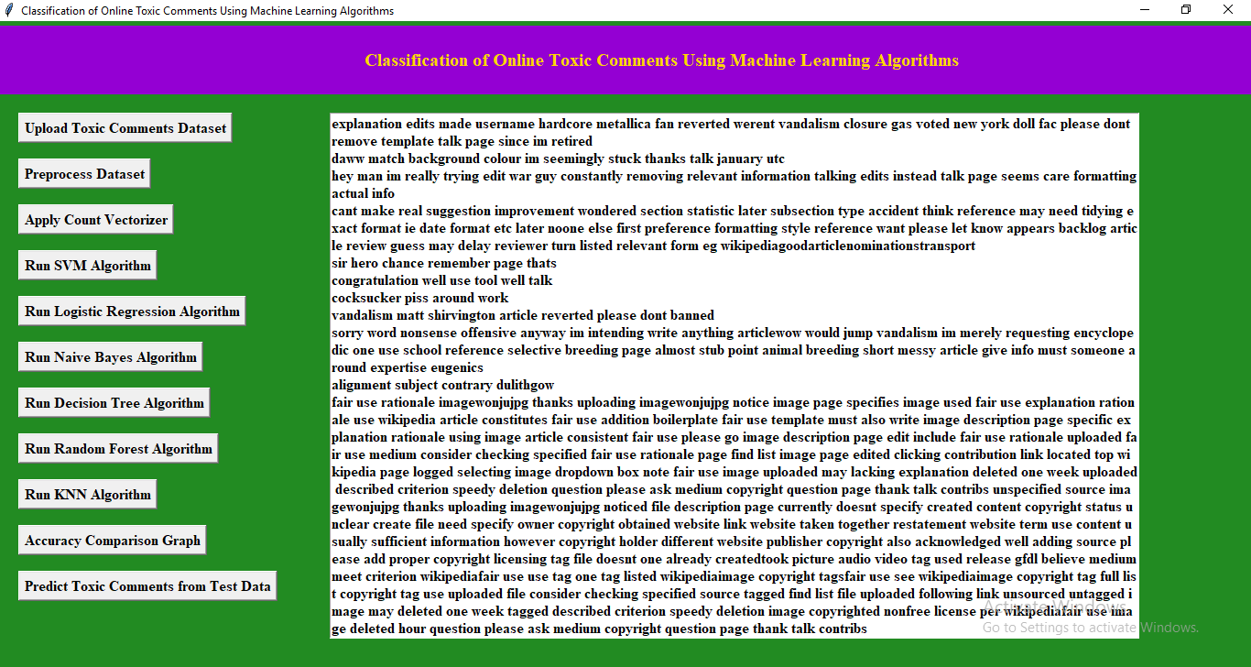
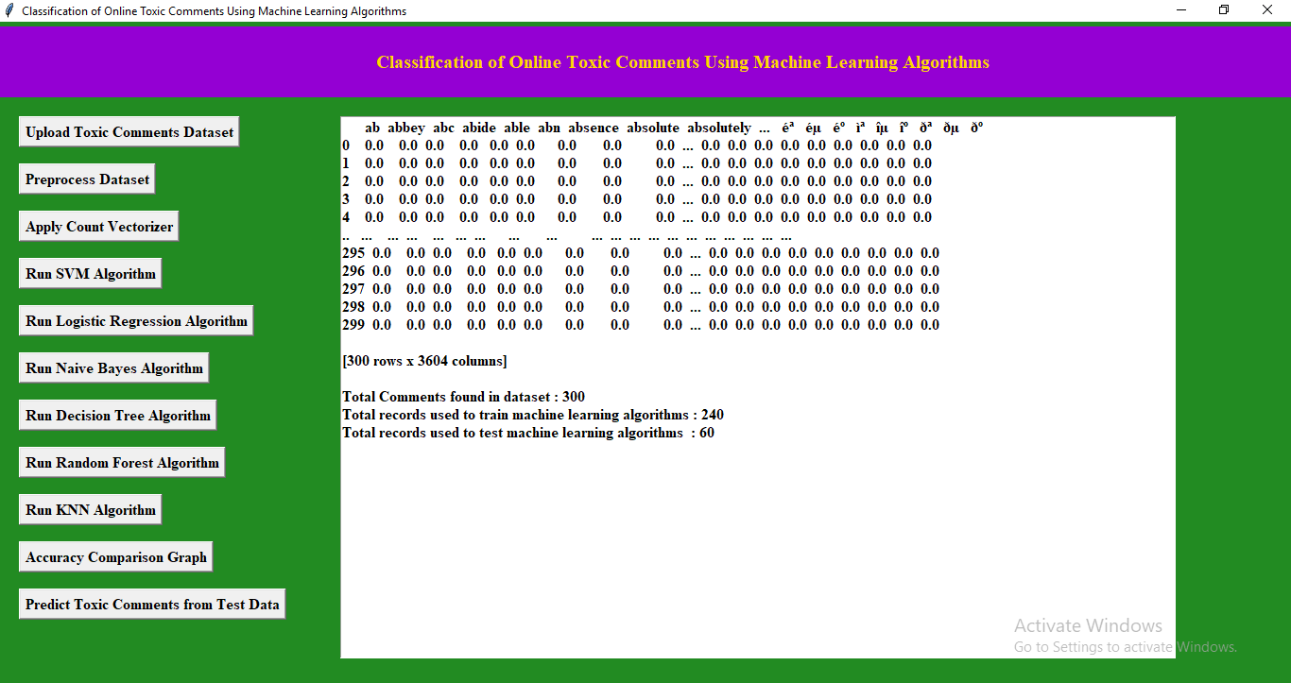

Slide 19
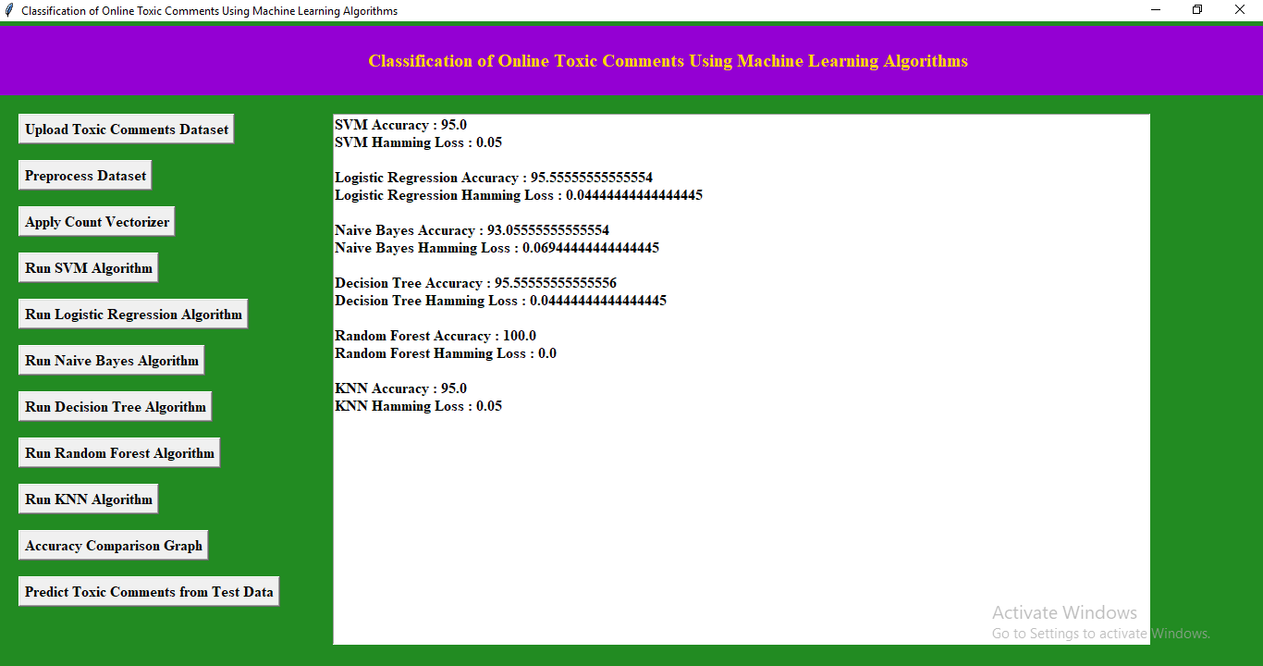
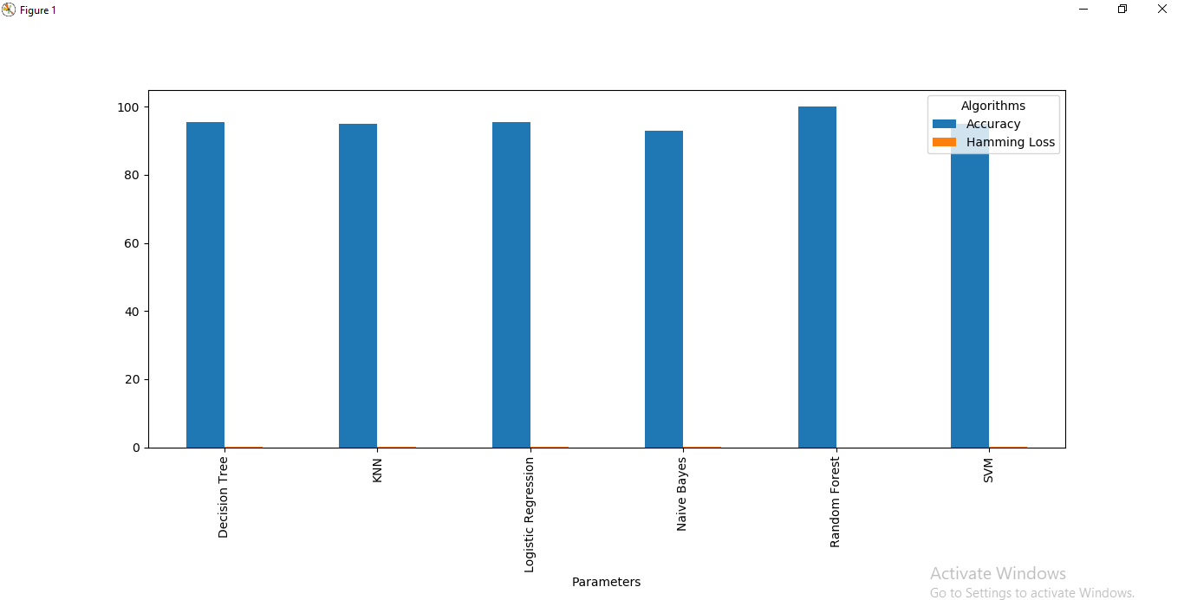

Slide 20
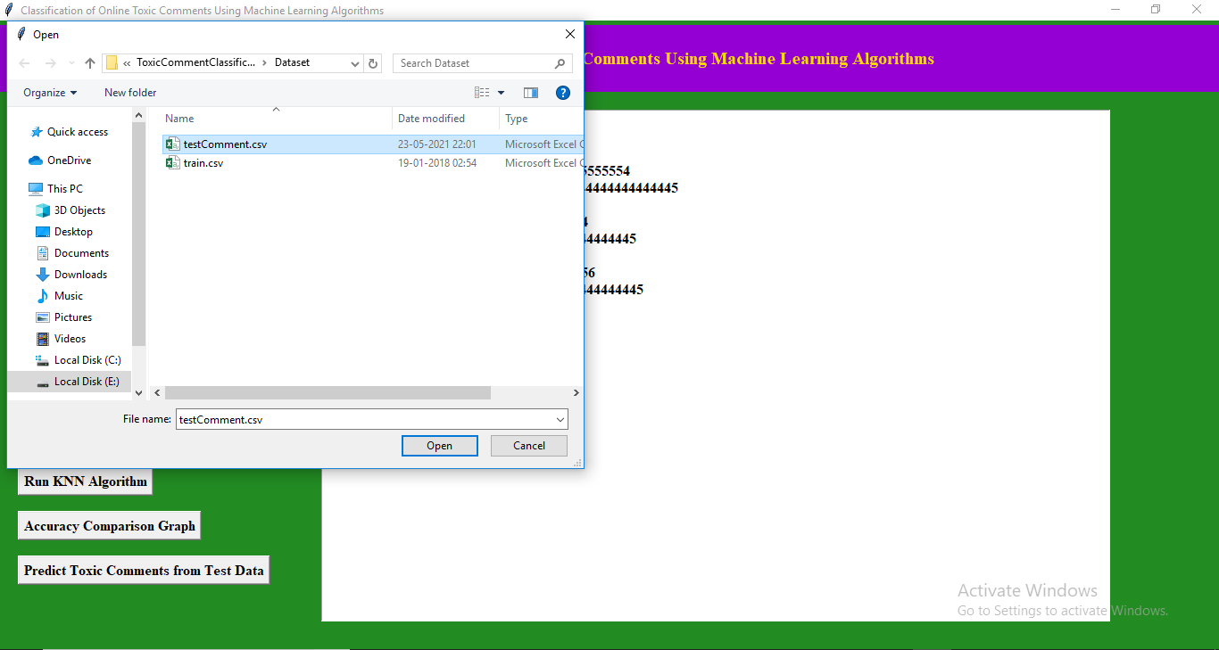
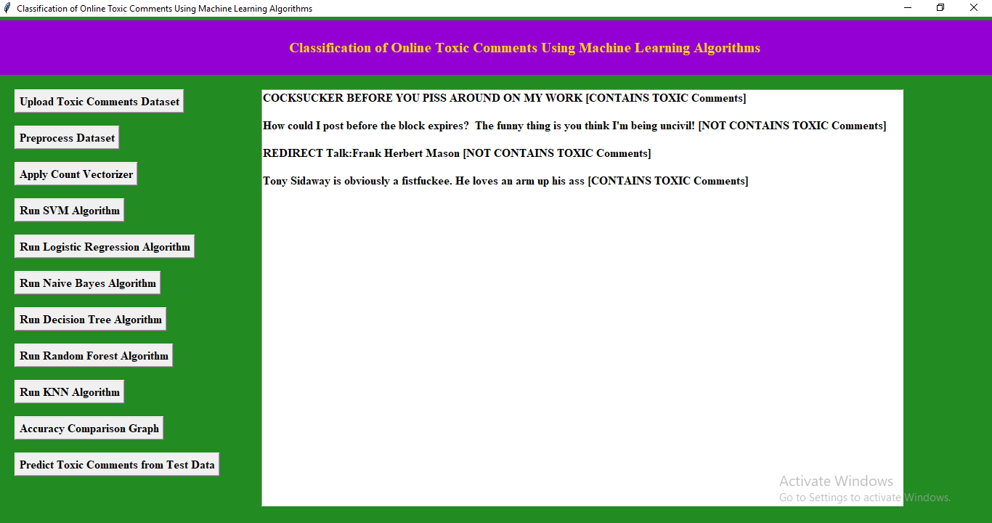

Slide 21
CONCLUSION
We have discussed six Machine learning techniques i.e. logistic regression, Naive Bayes, decision tree, random forest, KNN classification, and SVM classifier, and compared their hamming loss, accuracy, and log loss in this paper. Now after proper analysis, we can say that in terms of hamming loss, Random forest performs best. So, our final model selection will be based on the combination of hamming loss and accuracy. Since we got the maximum accuracy i.e. 100.0 % and least possible hamming loss i.e. 0.0 % in case of the Random forest model. We will select the Random forest model as our final machine learning technique since it works best for our data.

Slide 22
THANK YOU…

